Slide 1

Activation Function from Scratch - tf.nn

Slide 2
Reference
tf.keras.activations
Youtube
Code

Slide 3
Relu and Its Variants

Slide 4
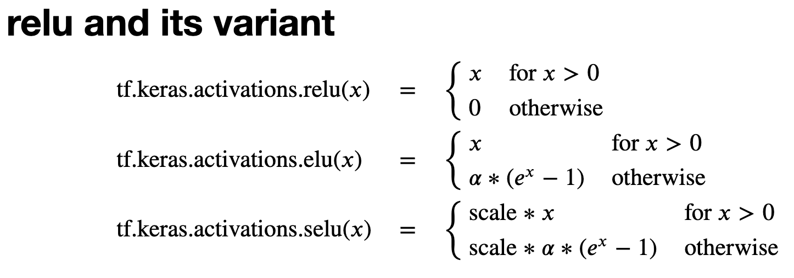

Slide 5
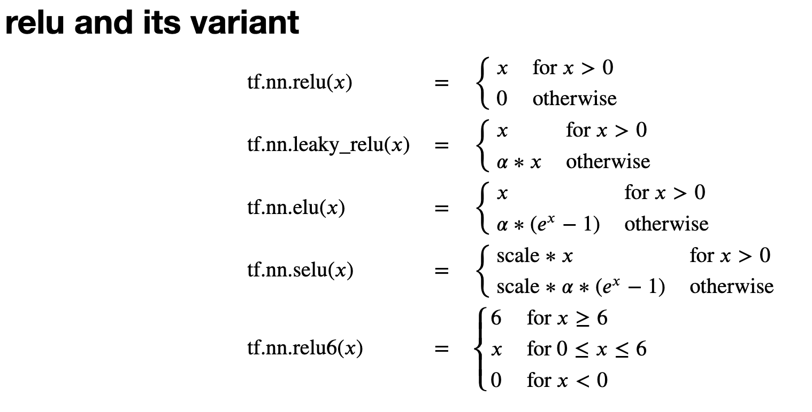

Slide 6
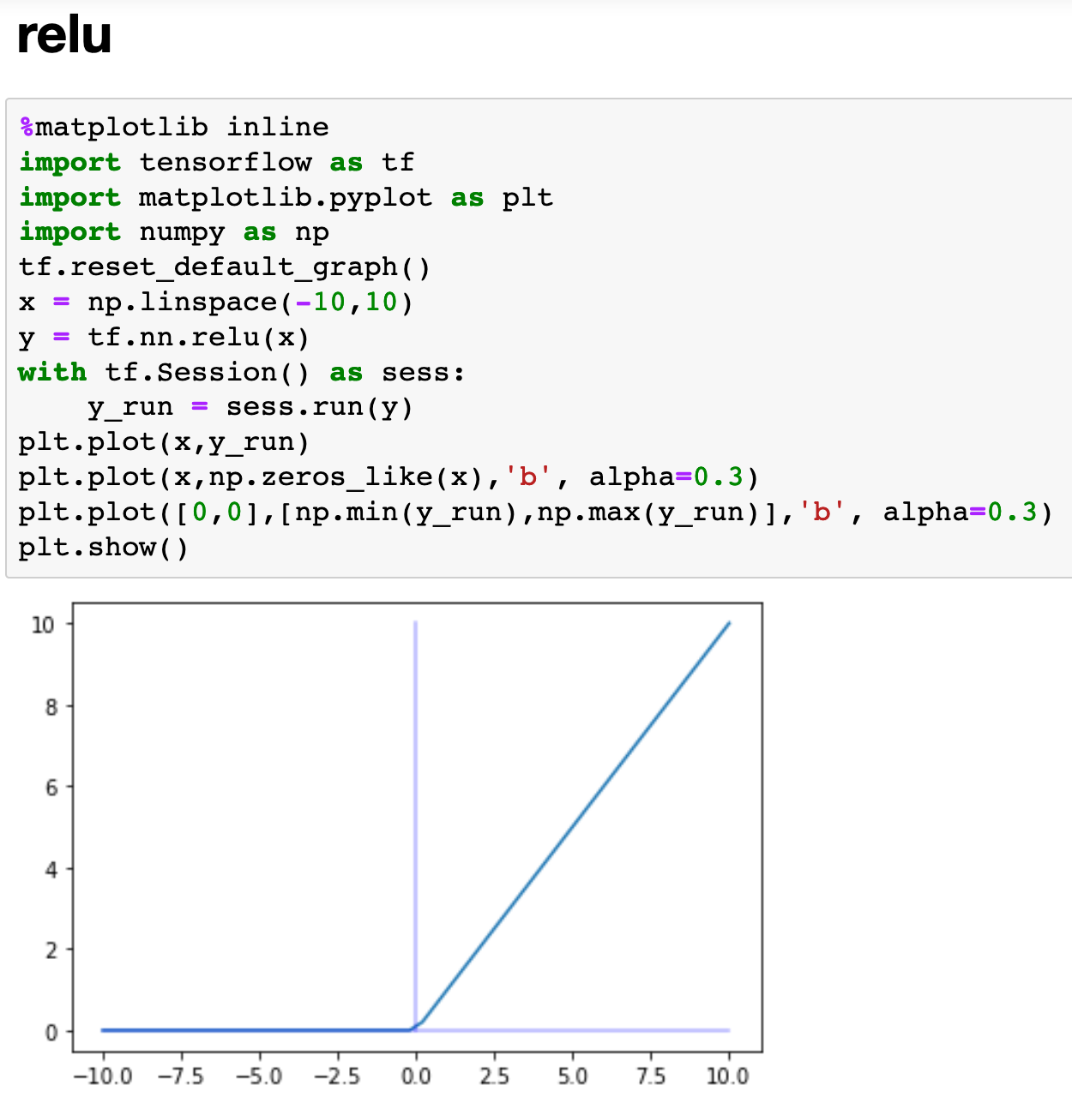

Slide 7
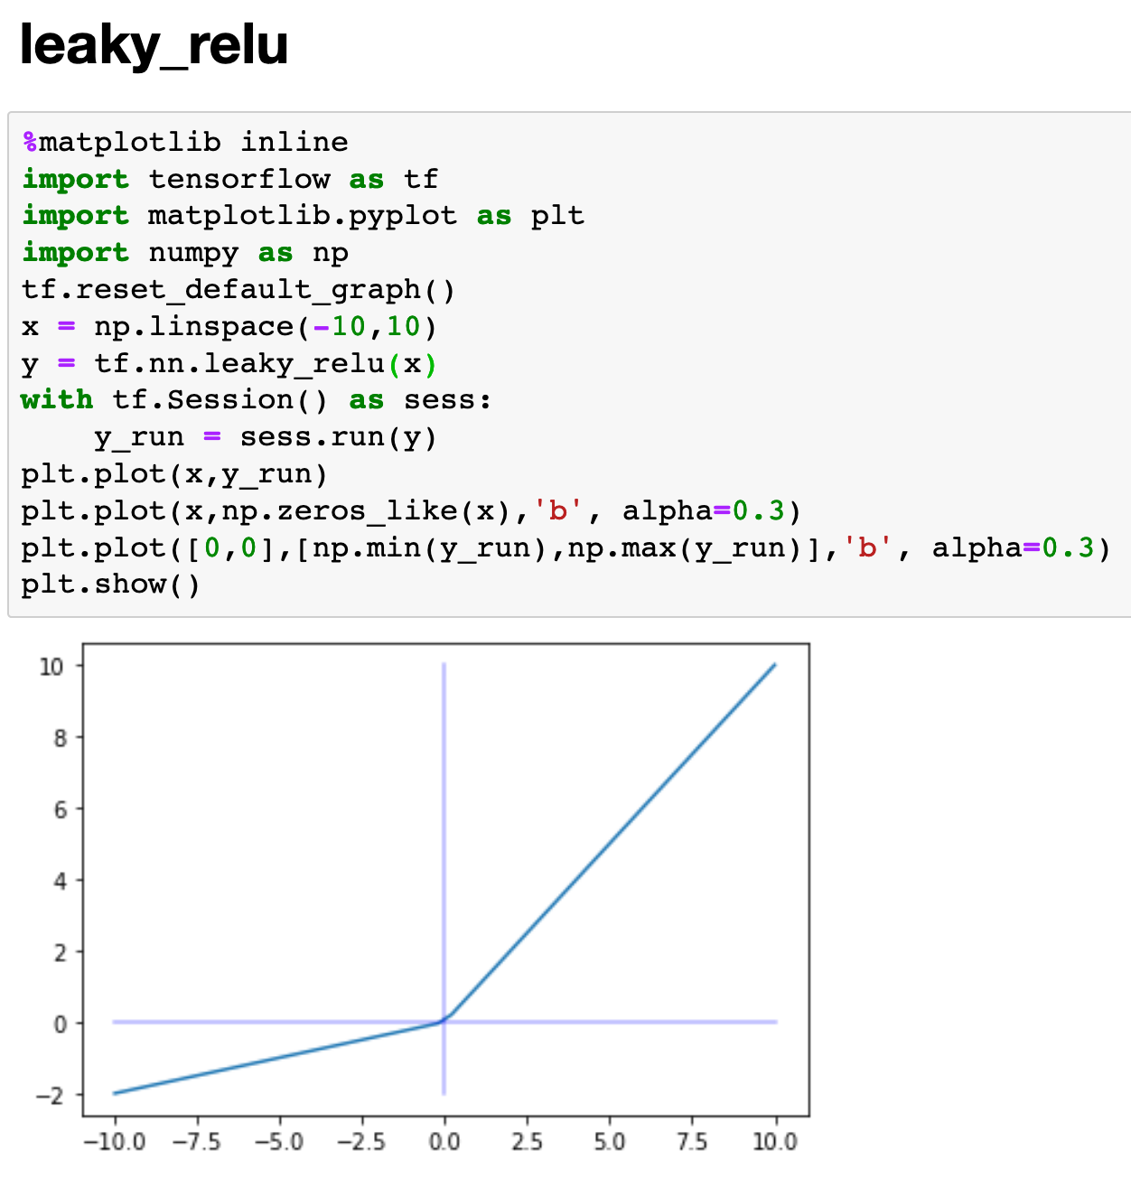

Slide 8
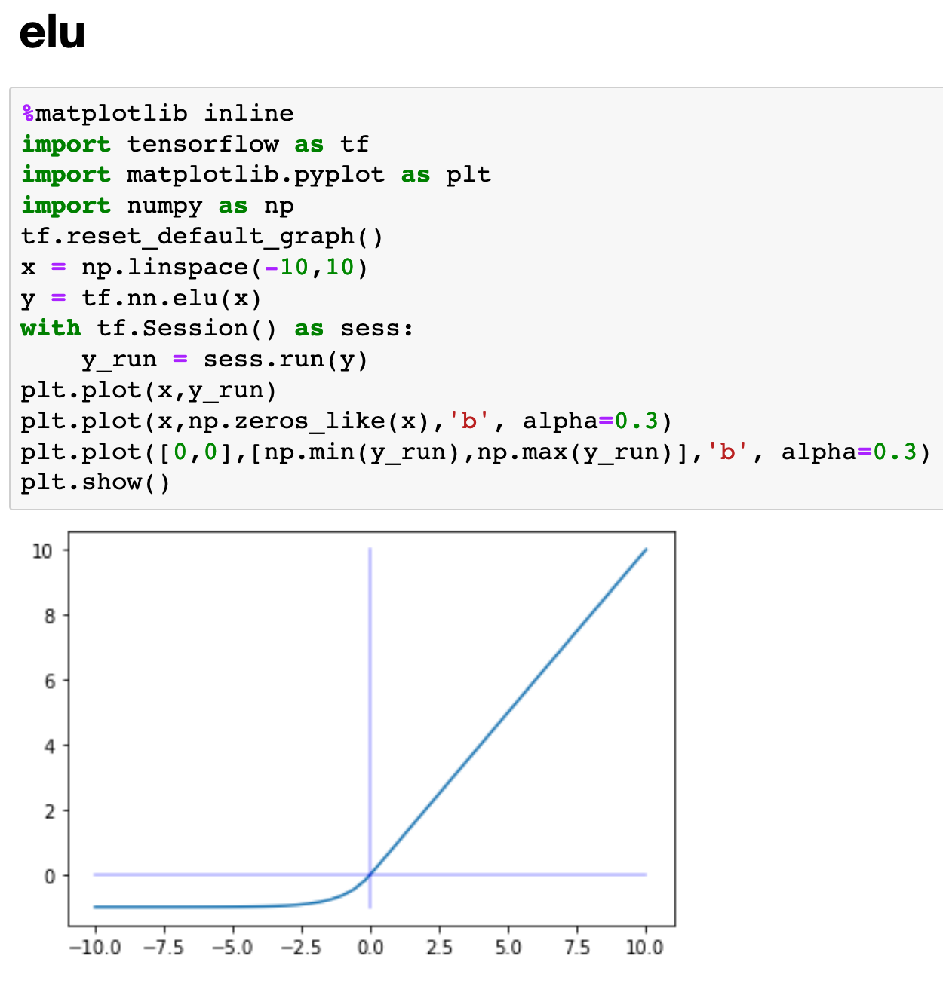

Slide 9
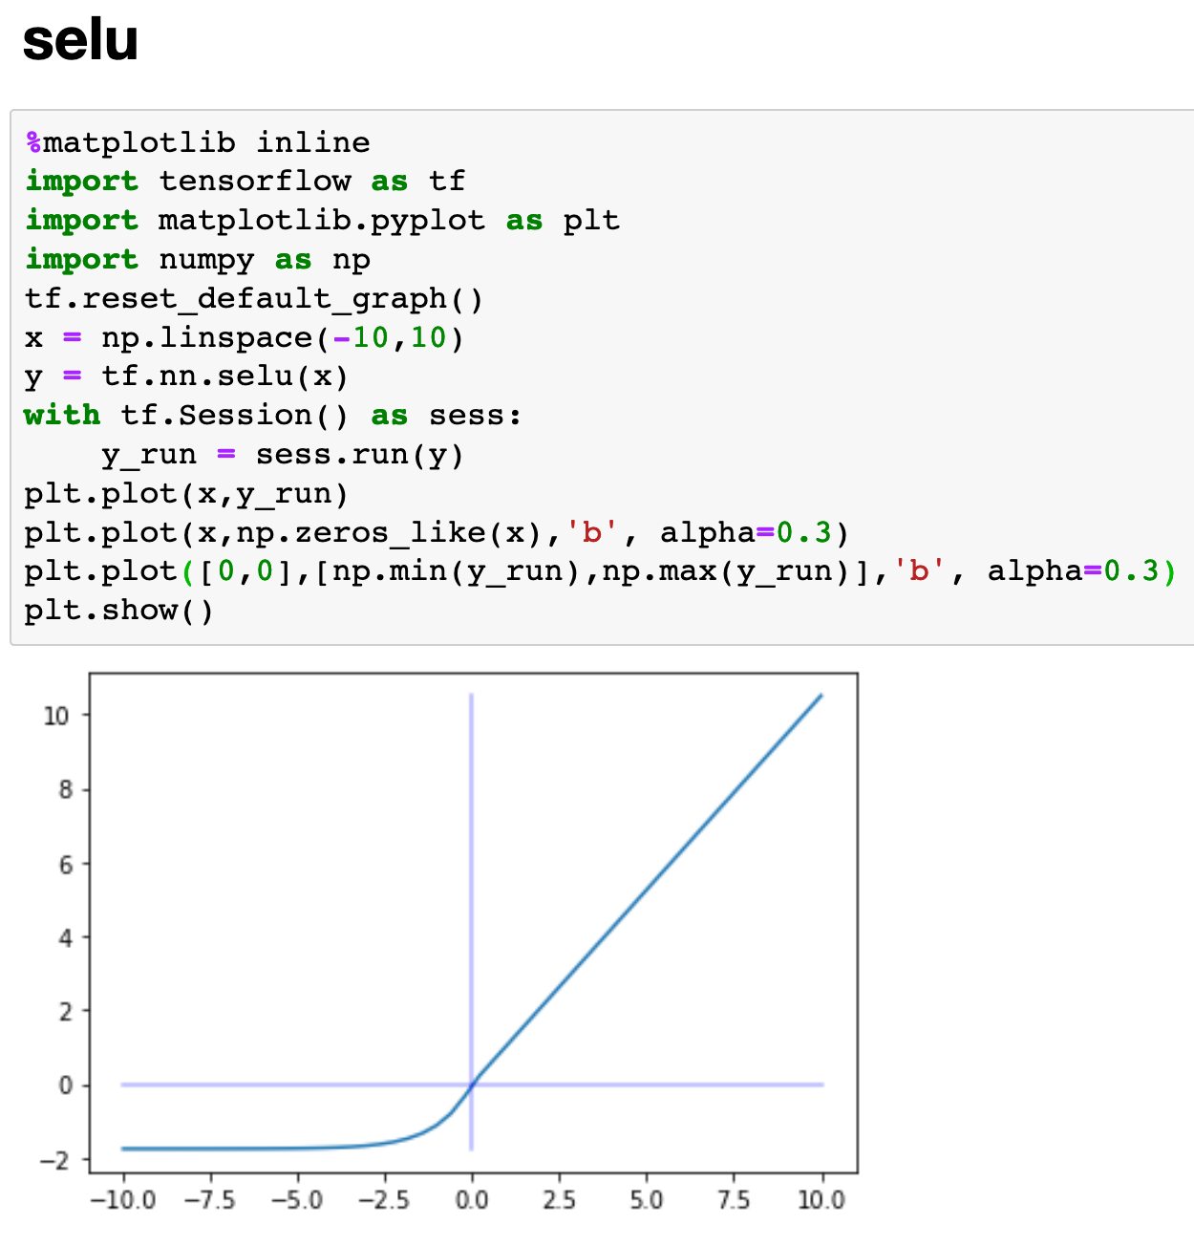

Slide 10
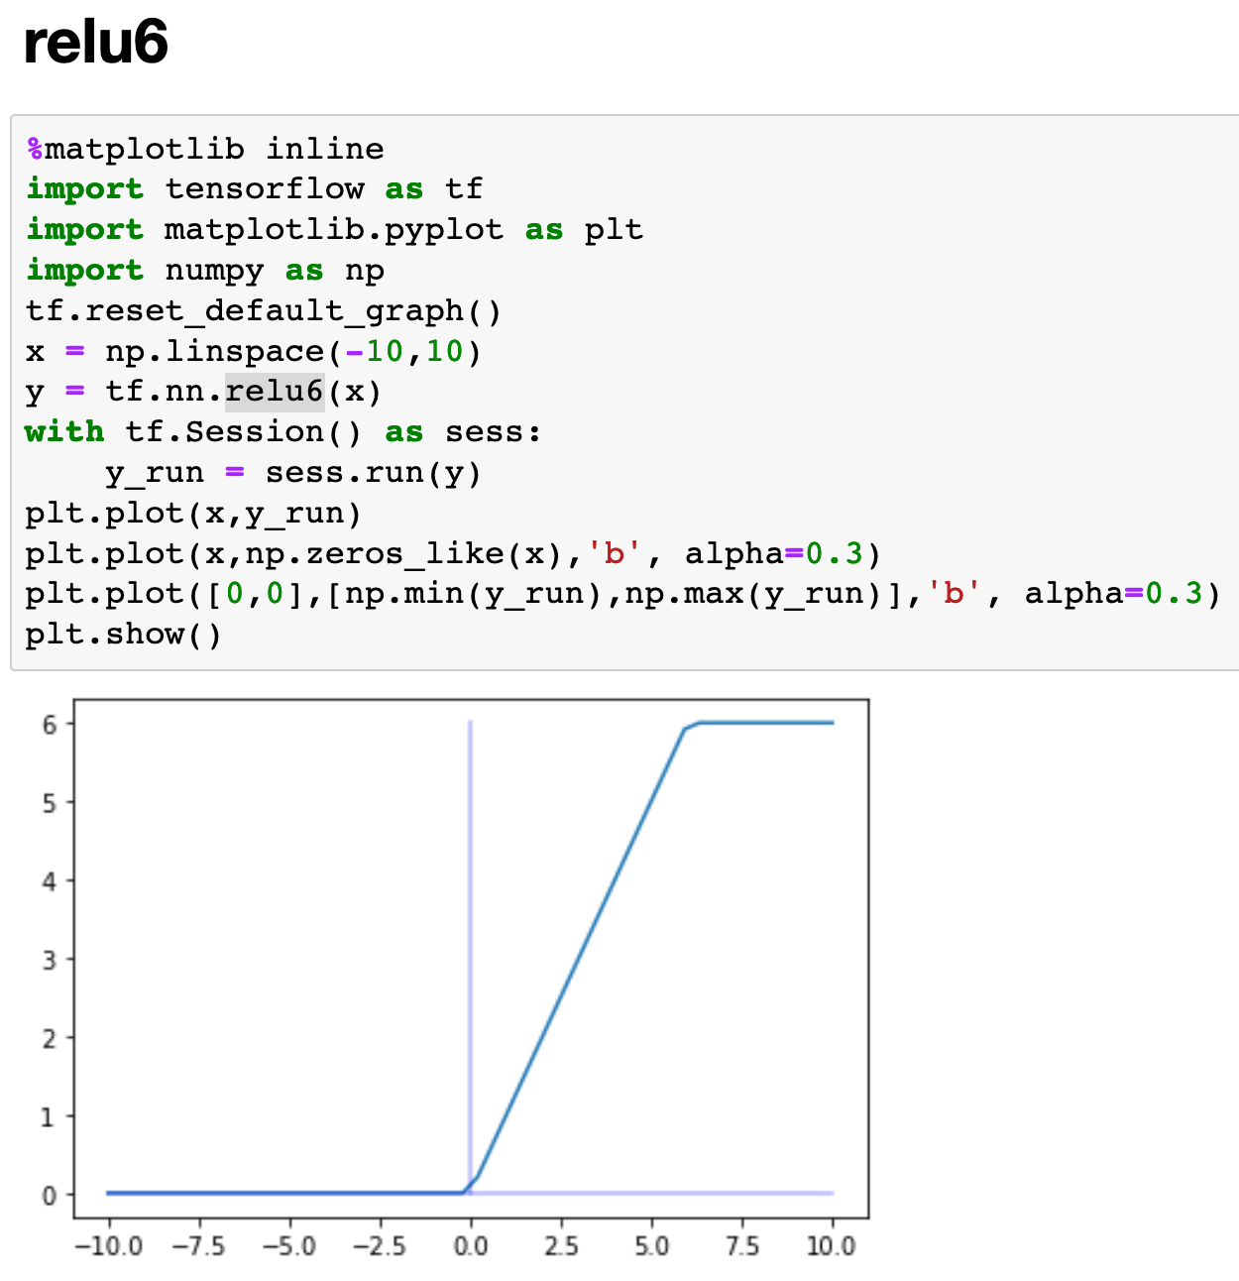

Slide 11
Sigmoid and Its Variants

Slide 12


Slide 13


Slide 14
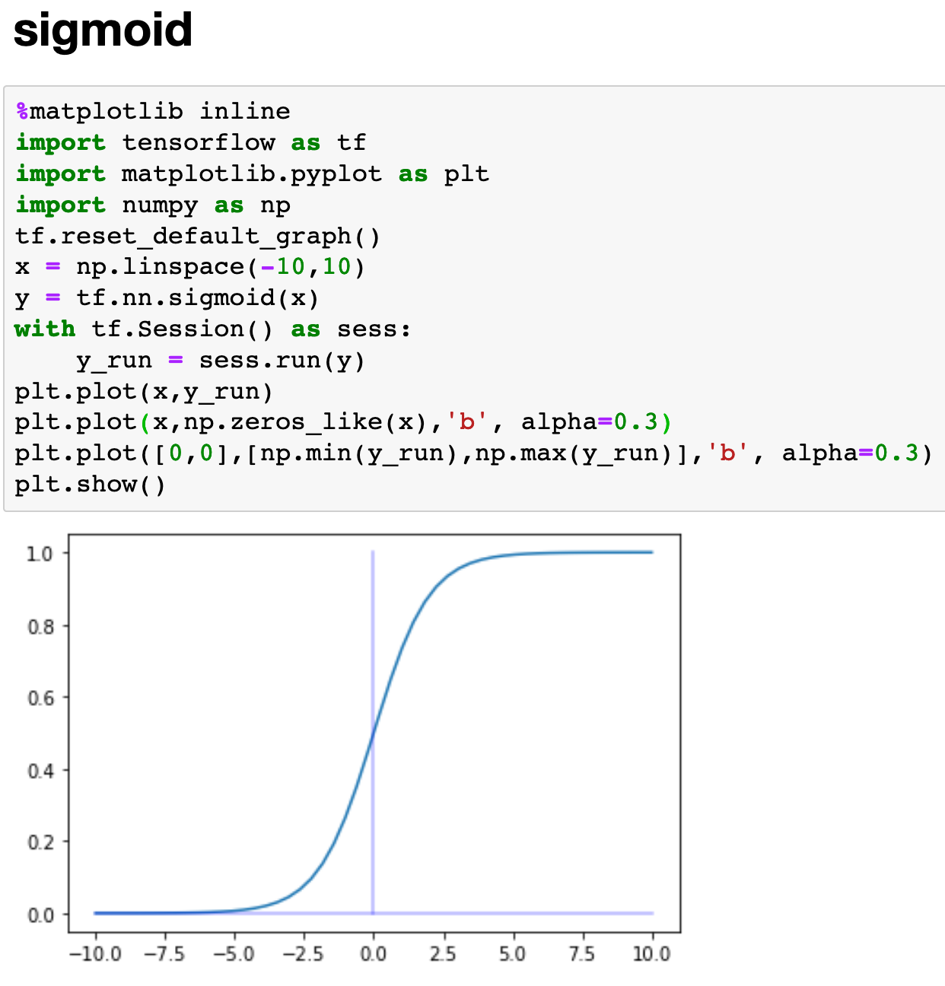

Slide 15
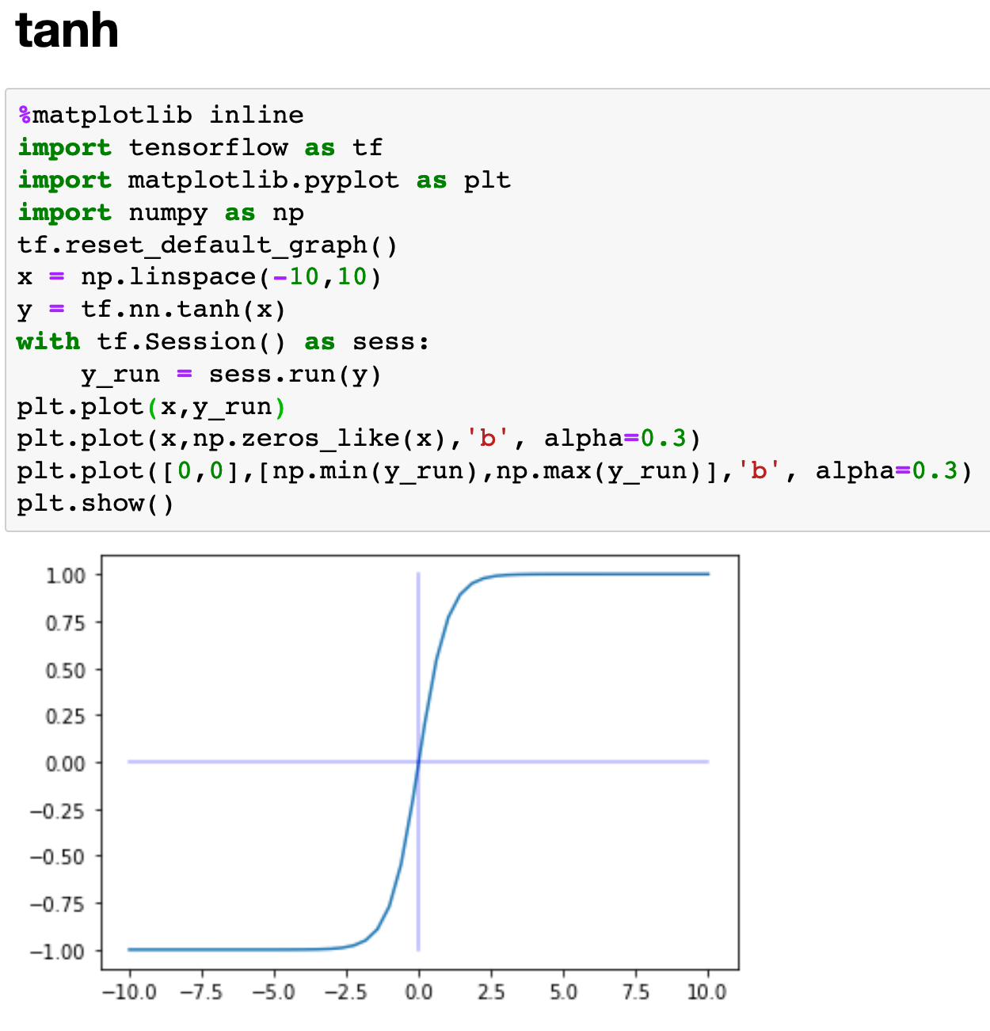

Slide 16
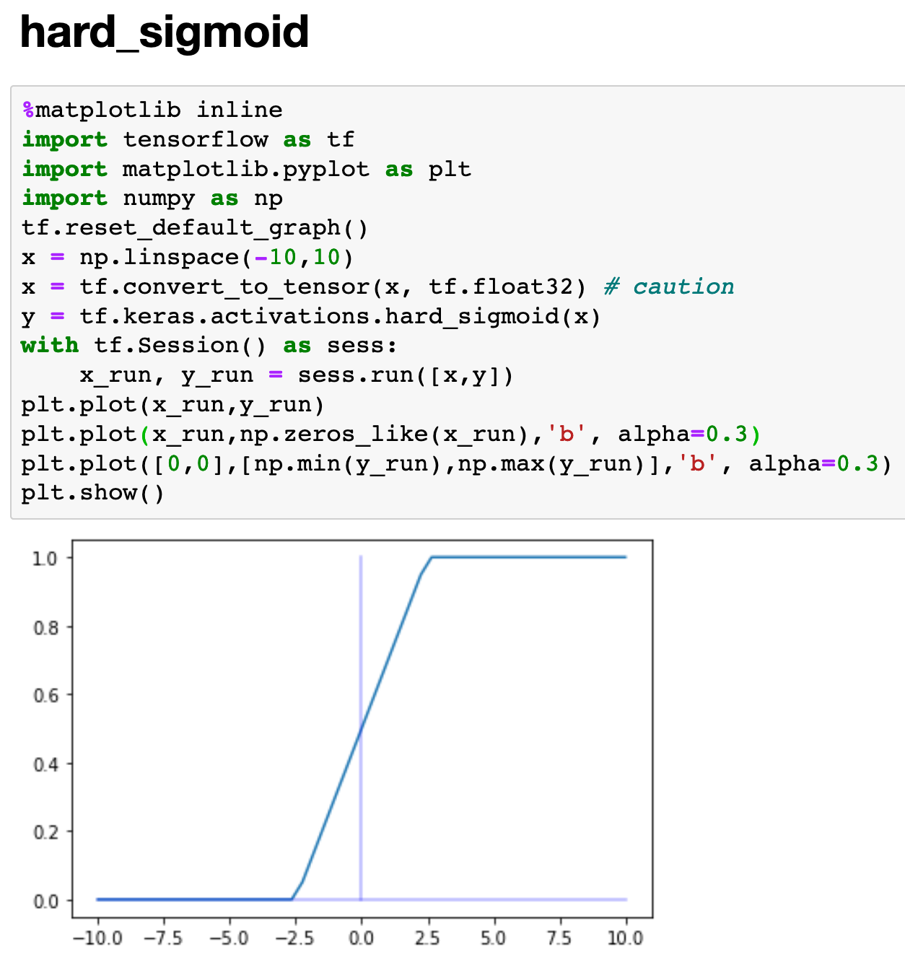

Slide 17
Softmax and Others

Slide 18


Slide 19


Slide 20
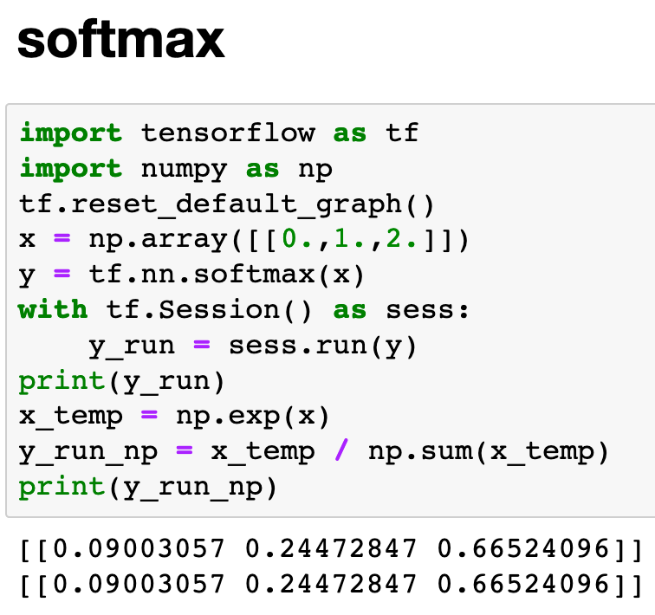

Slide 21
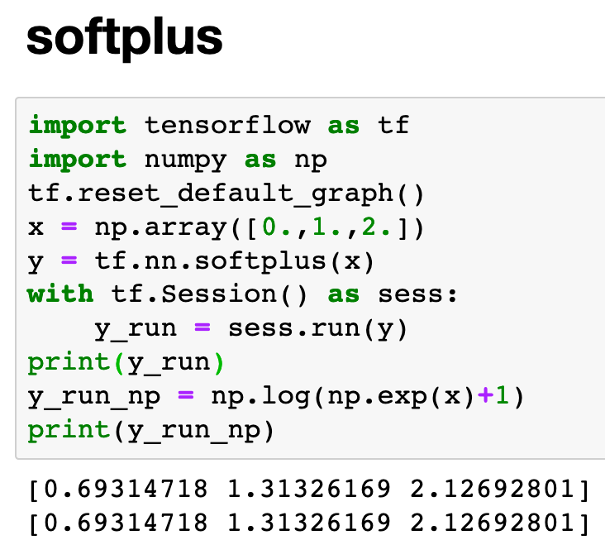

Slide 22
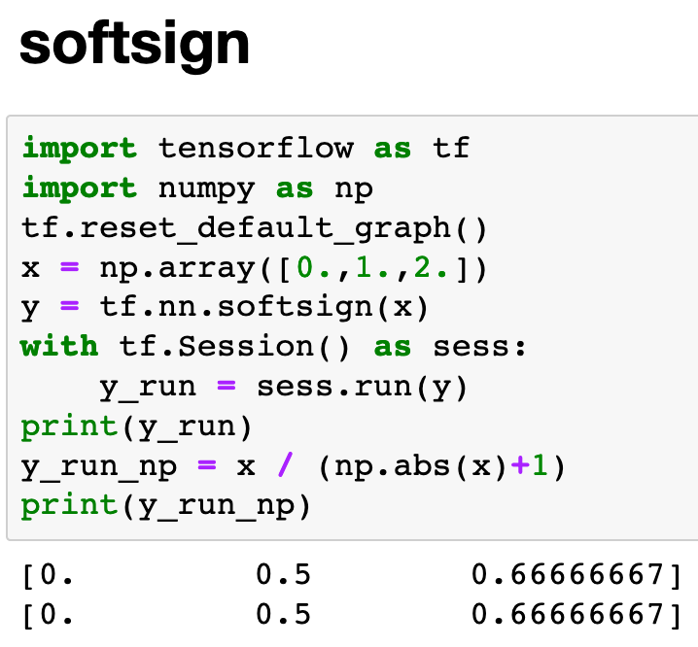

Slide 23
Now
Let’s Play with Code

